Slide 1
Basic Git and GitHub
Milan McGraw
Artificial Intelligence / Machine Learning Engineer
Please go to www.github.com and create an account.
Use your personal email address, if you have one, not your school email or work email. You don’t want to lose access when you graduate or go to another job.
You do not need to use your name as your account name – it can be something fun, but also you need to be prepared to live with it, maybe forever.
Then, download the repo here: https://github.com/Milan-Chicago/CityCollegesofChicago
Then, open up Terminal (Mac) or GitBash (Windows).

Slide 2
Goals for today
Get a GitHub account
Get git set up on your laptop
Get your git linked to your GitHub – this requires setting up 2FA to meet GitHub’s security requirements
Learn how to use git for version control
Learn how to send your local work to your GitHub site
Learn some of the git jargon

Slide 3
Today’s lesson
My materials are adapted from this lesson: https://swcarpentry.github.io/git-novice
To learn more functionalities of git, or to review what you’ve learned after this workshop, please check out that tutorial.

Slide 4
Code to set up git on your laptop
The dollar sign is your command prompt in your command line shell. You might have a different prompt instead of a dollar sign. You do not type the prompt when running these commands.
Use the name that you want to appear alongside your code (not your GitHub name, unless you used your actual name as your GitHub name).
Use the same email address that you used for GitHub.
$ git config --global user.name "Vlad Dracula"
$ git config --global user.email "vlad@tran.sylvan.ia"

Slide 5
Code to set up git on your laptop
Sometimes git might open up a text editor to help you add notes to keep track of your versions. You can set the text editor you want git to open. Here’s how to set it to vi:
$ git config --global core.editor "vi”
Here’s a list of other text editors, and the commands to run to set them as your default: https://swcarpentry.github.io/git-novice/02-setup.html#line-endings

Slide 6
Code to set up git on your laptop
Because Macs and PCs use slightly different hidden characters to represent line endings, you want git to treat them the same. We can run this code to do that.
ON A MAC
$ git config --global core.autocrlf input
ON A PC
$ git config --global core.autocrlf false

Slide 7
Configuring 2FA (Two-Factor Authentication)
This is a little complicated, but you have to do it to use GitHub. GitHub takes security very seriously, and so should you!
The best way to do this is to use a time-based one-time password (TOTP) application on your phone, like Duo Mobile, the same app most people use for 2FA for Northwestern log-ins.
Go to https://docs.github.com/en/authentication/securing-your-account-with-two-factor-authentication-2fa/configuring-two-factor-authentication#configuring-two-factor-authentication-using-a-totp-app and follow the instructions to link your GitHub account to Duo Mobile.
If you can’t use Duo Mobile, you can use text message for 2FA. Follow these instructions: https://docs.github.com/en/authentication/securing-your-account-with-two-factor-authentication-2fa/configuring-two-factor-authentication#configuring-two-factor-authentication-using-text-messages. Text message 2FA does not work in every country, so it is not the preferred method.

Slide 8
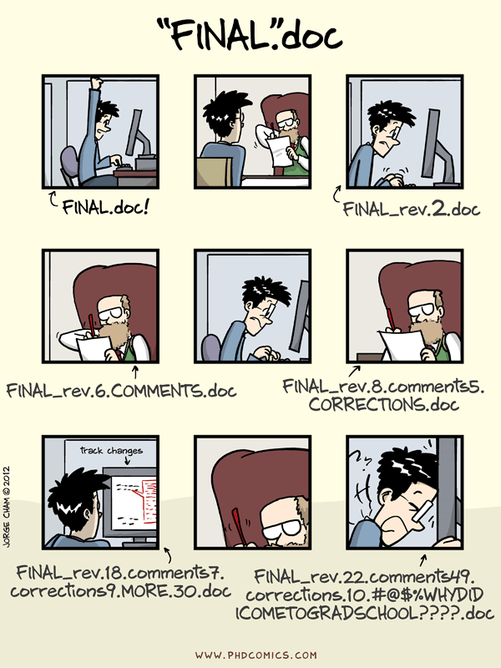
Version control (whiteboard talk)

Slide 9
Create a repo (aka a repository)
A repo is a folder (aka directory) on your computer. We will add a hidden subdirectory to the folder to officially make it a git repo. That means that it can start collecting version control data for this folder.
NAVIGATE TO DESKTOP
$ cd ~/Desktop
MAKE NEW DIRECTORY
$ mkdir planets
CHANGE INTO THE NEW DIRECTORY
$ cd planets
MAKE THE NEW DIRECTORY A REPO
$ git init

Slide 10
Create a repo (aka a repository)
Don’t make repos inside repos.

Slide 11
Create a repo (aka a repository)
CHECK WHAT’S IN YOUR REPO
$ ls
CHECK WHAT’S IN YOUR REPO (including hidden files)
$ ls -a

Slide 12
Checking the staging area
$ git status

Slide 13
Make changes in your repo (this code is for the vi text editor, or you can use the text editor of your choice)
$ touch mars.txt
$ vi mars.txt
Enter “i” and then add this text:
Cold and dry, but everything is my favorite color
Press the esc key and then enter “:wq” to save your changes.
Check the staging area:
$ git status

Slide 14
Add changes to the staging area
$ git add mars.txt
$ git status

Slide 15
Ready to create a save point? Make a commit.
When we make a commit, we need to give it a name. The name is called a message. It should say what changes you made since your last commit.
We are going to use a flag to enter the message in the same line of code as we make the commit. Otherwise, git will open up our text editor for us to enter the message, which wastes time.
$ git commit –m “Start notes on Mars as a base”
$ git status

Slide 16
DIY
Add this new line of text to the mars.txt file: “The two moons may be a problem for Wolfman”. Then check git status. Then add the change to the staging area and make a commit. Don’t forget to name your commit with a message. Also, these commits will get added to your GitHub later today, where they will exist forever, so don’t name your commit something you’ll regret.

Slide 17
Check our status
$ git status
$ git log

Slide 18
Create a new repo on your GitHub site
Use the same name (“planets”). Make it public (for now).
If you are on a Mac and you have issues with pushing your repo, try following these instructions: https://ginnyfahs.medium.com/github-error-authentication-failed-from-command-line-3a545bfd0ca8

Slide 19
Push the existing local repo to the GitHub remote repo
Choose HTTPS and run the code given to you on GitHub to push an existing repo.

Slide 20
DIY
In your local repo, add a new folder inside the “planets” folder. Call it ”spaceships”. You don’t need to redo the git init. Remember: don’t make repos inside repos. It is ok to make subfolders inside a repo though.
Git will not track an empty directory – it waits until there is a file inside. Add an empty file inside the ”spaceships” directory called “apollo-11.txt”.
Add the new file to the staging area, make a commit (with a message), and then push the changes to your remote repo with this line of code:
$ git push –u origin main
The –u helps deal with those pesky line endings, plus other character inconsistencies between operating systems.

Slide 21
DIY again, if you want more practice
Add text to the “apollo-11.txt” file.
Add the new file to the staging area, make a commit (with a message), and then push the changes to your remote repo with this line of code:
$ git push –u origin main
The –u helps deal with those pesky line endings, plus other character inconsistencies between operating systems.

Slide 22
Local vs. remote
Let’s talk about how your local (your computer) and remote (your GitHub) storage differs.
Push, Pull, Fork, and Clone
How to sync your remote and local repos, how to push to a GitHub org, how to borrow code, how to collaborate with low risk vs. collaborate more seriously.

Slide 23
Next lesson…
https://swcarpentry.github.io/git-novice/04-changes.html
You can reach out to my team for coding and data help at any time – bit.ly/rcdsconsult.

